Slide 1



DIGITAL
DISRUPTION
GROUP 3 : BLOCKCHAIN & SECURITY OF TRANSACTIONS
Presented To: DR. D.N. PANDEY

Slide 2





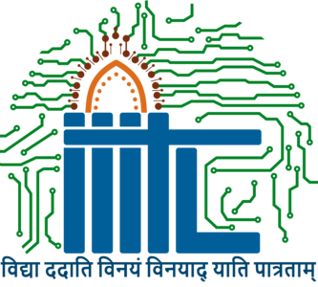
GROUP 3
Team Details
Sakshi Shukla
MDB23007
Upasana Boro
MDB23017
Harsh Pandey
MDB23019
Priya Ranjan
MDB23021
Indian Insititute of Information Technology, Lucknow

Slide 3
Table of Contents
What is Blockchain?..................................................................01-04
How is Blockchain Implemented?....................................................05
What is Blockchain Security?.....................................................06-09
Legal Status of Blockchain & Cryptocurrencies..............................10
Blockchain Use Cases................................................................11-16
Challenges in Blockchain................................................................17
Future Trends and Prospects in Blockchain.....................................18
Ethical and Implications of Blockchain Technology.........................20
Conclusion........................................................................................

Slide 4


A DELOITTE REPORT SAYS THAT 40% OF FINANCIAL SERVICES FIRMS ARE INVESTING IN BLOCKCHAIN TECHNOLOGIES TO STREAMLINE OPERATIONS AND IMPROVE CUSTOMER EXPERIENCES.
But why all this fuss?
What is Blockchain Technology?
$ 69 Billion
68% CAGR
Predicted Blockchain Tech
Market by 2032
Source: Custom Market Insights
Forecasted Growth Rate between 2023-32
Source: Custom Market Insights
01
Harsh

Slide 5
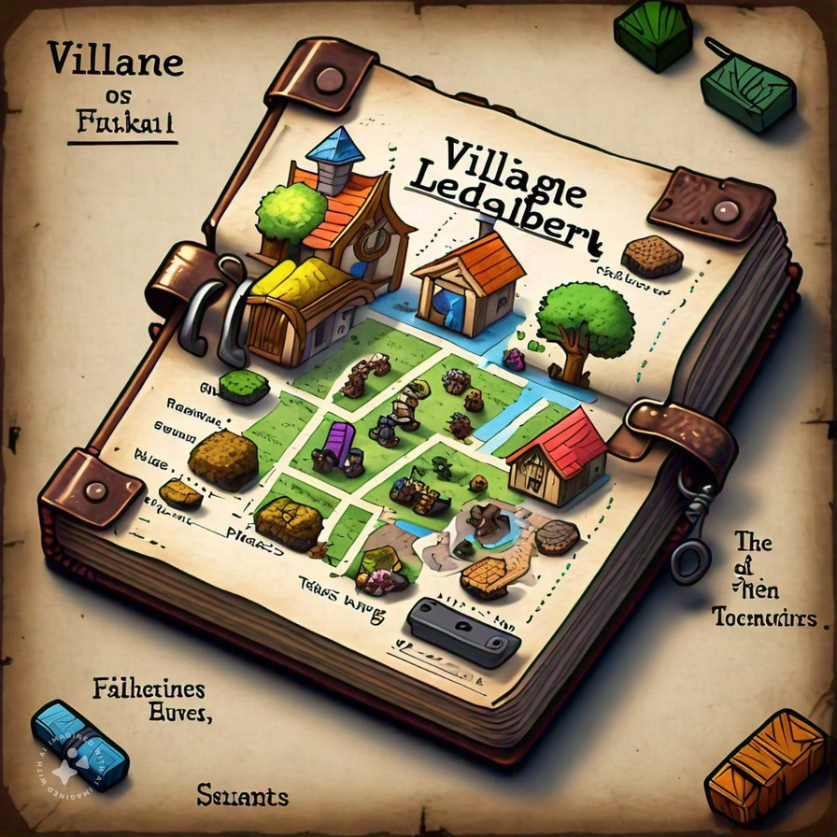
Let’s understand this with a simple example...
Blocks: Groups of transactions (like a page in the ledger)
Chain: Linked blocks creating a permanent record
Nodes: Village elder or community members verifying transactions
Consensus: Agreement among nodes on transaction validity
Cryptography: Secure locking and linking of blocks
02
Harsh

Slide 6
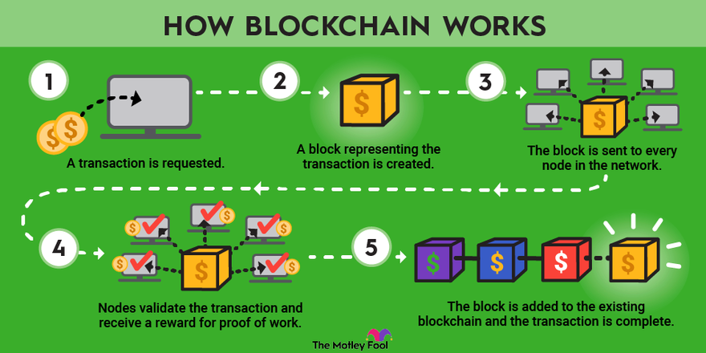
Okay! We get it, not complex at all.
But wait...
03
Harsh

Slide 7
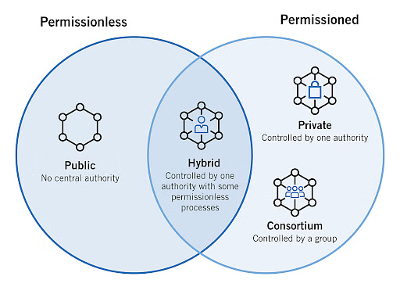
Types of Blockchain Networks...
Public Blockchain Networks
Private Blockchain Networks
Consortium Blockchain Networks
04
Harsh

Slide 8
How do we implement blockchain?
We have multiple consensus mechanisms for that such that :
Proof of Work (PoW)
Proof of Stake (PoS) , etc
There are multiple ways to implement the same, like:
Smart Contracts: Automate and enforce agreements without intermediaries, reducing costs and speeding up processes.
Decentralized Applications (DApps): Provide services without central control, enabling innovations like peer-to-peer lending and decentralized exchanges.
Blockchain as a Service (BaaS): Allows banks to build blockchain solutions without infrastructure, with providers like IBM and Microsoft leading the market.
05
Harsh

Slide 9
What is Blockchain Secruity?
Blockchain security is a comprehensive risk management system for a blockchain network. It uses cybersecurity frameworks, assurance services and best practices to reduce risks against attacks and fraud
How security differs by blockchain types
Public Blockchains
Private Blockchains
Permissionless Blockchains
Permissioned Blockchain
06
Priya Ranjan

Slide 10


Digital Signature and Authentication
A digital signature is a cryptographic technique used to verify the authenticity of a message, transaction, or document.
How it is generated for a blockchain transcation
Public and Public Key Pair
Hashing
Encryption
Verification
Adding to Network
07
Priya Ranjan

Slide 11


Process of Blockchain Transaction Verification System
Significance
How verification works
Trust and Secruity
Immutability
Eliminating Intermediaries
Transaction Propagation
Consensus Management
Proof-of Work
Proof-of Stake
Delegated proof-of Work
Practical Byzantine Fault Tolerance (PBFT)
08
Priya Ranjan

Slide 12

Verification Steps
Transaction Validity
Consensus Mechanism Execution
Block Creaters
Block Confirmation
09
Priya Ranjan

Slide 13
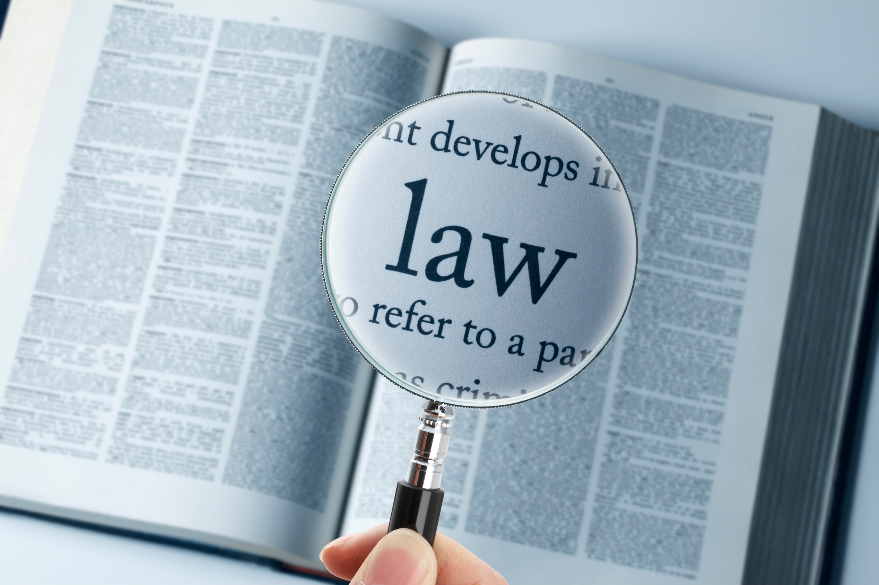
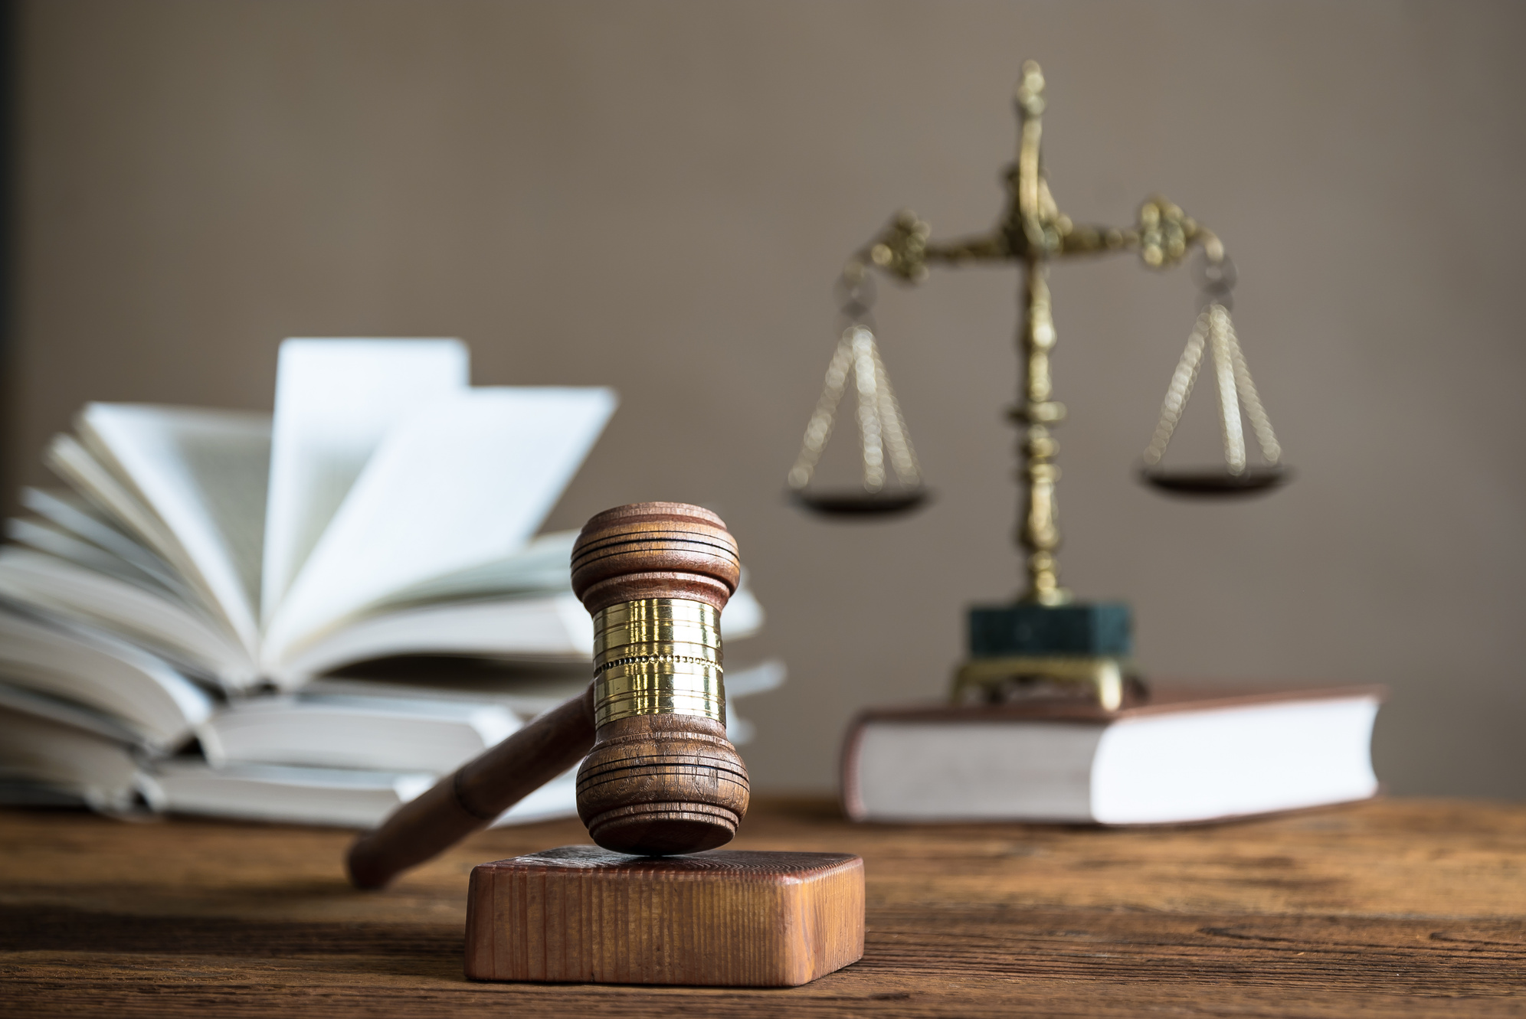
Legal Status of Blockchain and Cryptocurrencies
Supreme Court’s Ruling and Its Impact
The RBI’s Circular and Its Impact
Post-Supreme Court Ruling: Regulatory Developments
Draft Bill: The Cryptocurrency and Regulation of Official Digital Currency Bill, 2021
Jurisdictional Challenges
Technology-Neutral Regulatory Regime
Governance and Legal Documentation
Intellectual Property and Personal Data Privacy
10
Priya Ranjan

Slide 14

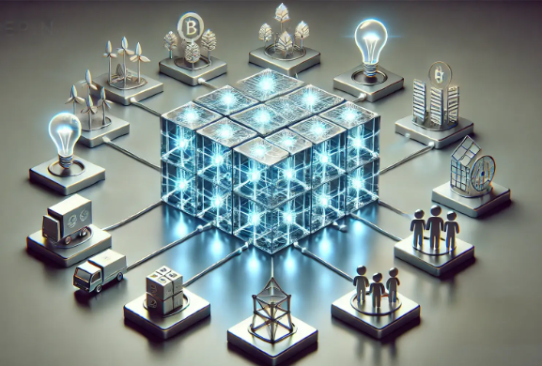

BLOCKCHAIN USE CASES
Let us have a glimpse into Blockchain Applications Across Industries
11
Upasana

Slide 15

BLOCKCHAIN IN SUPPLY CHAIN
IBM FOOD TRUST NETWORK
EVERLEDGER’S DIAMOND SUPPLY CHAIN
Walmart Canada uses IBM Blockchain technology to add transparency to decentralize food supply system by digitalising the food supply chain process
Everledger uses blockchain to create a digital twin/ digital identity for the diamonds based on its characteristics
12
Upasana

Slide 16
BLOCKCHAIN IN FINANCIAL SERVICES
RIPPLENET
BITCOIN
RippleNet is a blockchain based banking solution that provides a secure, instant and low-cost cross border payment network for banks and financial institutions.
Bitcoin is a blockchain based cryptocurrency that allows peer to peer transactions. It uses hash-based function and proof of work consensus mechanism
13
Upasana

Slide 17
BLOCKCHAIN IN HEALTHCARE
MEDILEDGER
BURSTIQ
MediLedger is a blockchain based platform launched in 2019.It is used to track and verify the authenticity of medication or products sold.
BurstIQ provides enterprise level blockchain solutions for the healthcare industry. It works on a Peer-to-Peer basis.
14
Upasana

Slide 18
BLOCKCHAIN IN VOTING SERVICES
REMOTE VOTING CHAIN- POC (INDIA ELECTIONS)
VOATZ (U.S ELECTIONS)
The Remote Voting System is a Blockchain based voting distributed system developed by the National Informatics Centre, under the Ministry of Electronics & Information Technology, Govt of India
In 2018, The West Virgina Government initiated the nation’s first mobile voting application Voatz for the UOCAVA (The Uniformed and Overseas Citizens Absentee Voting Act) voters.
15
Upasana

Slide 19
BLOCKCHAIN IN IDENTITY VERIFICATION & MANAGEMENT
CIVIC
MICROSOFT ION
Civic is a blockchain based tokenized identity management solution for the verifiable web empowering people to privately manage their identities across chains with an on-chain representation of their identity.
Microsoft ION is an open, public, permissionless layer 2 decentralized identifier network that runs atop the bitcoin blockchain.
16
Upasana

Slide 20


CHALLENGES
Scalability
Security & Privacy
Limited transactions per second on Bitcoin and Ethereum.
Vulnerability to cyber threats and smart contract exploits.
Interoperability
Difficulty in connecting different blockchain platforms.
Regulatory Hurdles
Different countries have varied policies regarding blockchain use, impacting its growth.
Energy Consumption
Environmental concerns due to high energy usage in proof-of-work systems.
17
Upasana

Slide 21

FUTURE TRENDS AND PROSPECTS IN BLOCKCHAIN
The Merging of Artificial Intelligence with Blockchain technology that is defined as the concept of decentralized AI is a recent innovation that has the fusion of processing, analytics and decision making in which the data is secure, digitally signed and carefully stored on the blockchain. The decision that are taken by using Blockchain are inflexible, transparent, and traceable to all participants, this leads the autonomous systems that are driven by smart transactions to adapt and make accurate decisions.
18
Sakshi

Slide 22
CASE STUDY: WALMART'S FOOD TRACEABILITY
Walmart, a global retail giant, has been at the forefront of adopting blockchain technology in its supply chain. The company's Food Traceability initiative aims to track food items from farm to fork, ensuring safety, quality, and efficiency. As they have been using the traditional supply chain methods that lack efficiency, transparency and can lead to fraud, new and promising technological solutions should be adopted to increase efficiency, transparency and security in supply chain management.
19
Sakshi

Slide 23
ETHICAL AND SOCIAL IMPLICATIONS OF BLOCKCHAIN TECHNOLOGY
Privacy related to data security is a very important Implication.
Decentralized blockchain Networks should have better consideration for governance as such technology can be used for several unethical purposes.
Blockchain technology has been revolutionized as one of the most effective innovations of our time.
Blockchain technologies helps in eradicating financial services restrictions and in the reduction of costs.
Blockchain technology leads to transparency and accountability in various industries.
20
Sakshi

Slide 24


CONCLUSION
21
Sakshi

Slide 25
THANK YOU!

